Slide 1
Chapter 6
How to use CSS for page layout

Slide 2
Objectives
Applied
Given an HTML document, create a CSS style sheet that uses floating to implement a fixed or fluid page layout in two- or three-column format with both header and footer.
Knowledge
Describe the use of floating for page layout.
Describe the use of the clear property in a CSS rule set.
Distinguish between fixed and fluid page layout.
Describe the use of the CSS3 feature for text columns.
Describe the use of absolute, relative, and fixed positioning.

Slide 3
The HTML for a web page with a sidebar
<body>
<aside>
<p>The luncheon starts 15 minutes after the lecture ends</p>
</aside>
<main>
<p>Welcome to San Joaquin Valley Town Hall. We have some fascinating speakers for you this season!</p>
</main>
<footer>
<p>Please call today at (559) 555-1212 to get your tickets!</p>
</footer>
</body>

Slide 4
The CSS for floating the sidebar
body { width: 500px; }
main, aside, footer {
margin: 0;
padding: 0px 20px; }
aside {
margin: 0 20px 10px;
width: 150px;
float: right;
border: 1px solid black; }
footer { clear: both; }

Slide 5
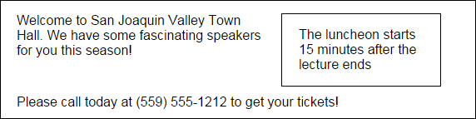
The web page with the side bar in a browser

Slide 6
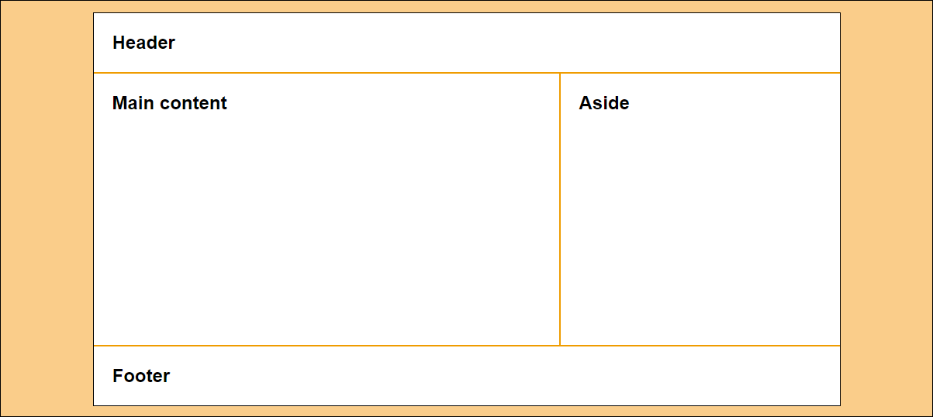
A 2-column web page with fixed-width columns

Slide 7
The HTML for the 2-column, fixed-width page
<body>
<header>
<h2>Header</h2>
</header>
<main>
<h2>Main content</h2>
</main>
<aside>
<h2>Aside</h2>
</aside>
<footer>
<h2>Footer</h2>
</footer>
</body>

Slide 8
The CSS for the 2-column, fixed-width page
* { margin: 0; padding: 0; }
body {
width: 962px;
background-color: white;
margin: 15px auto;
border: 1px solid black; }
h2 { padding: 1em; }
header { border-bottom: 2px solid #ef9c00; }
main {
height: 350px; /* to give the sidebar some height for its border */
width: 600px;
float: left;
border-right: 2px solid #ef9c00; }
aside {
width: 360px;
float: right; }
footer {
clear: both;
border-top: 2px solid #ef9c00; }

Slide 9
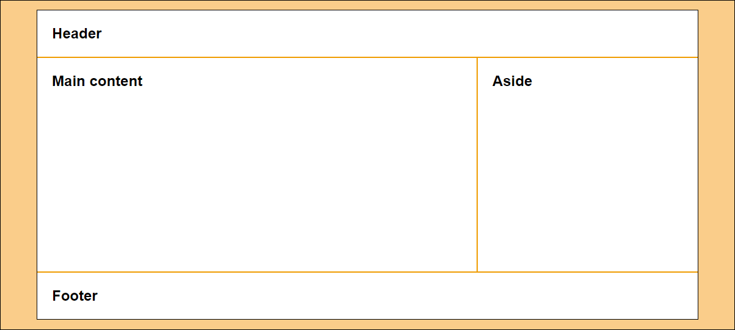
A 2-column page with fluid column widths

Slide 10
The CSS for the 2-column, fluid page
body {
width: 90%;
background-color: white;
margin: 15px auto;
border: 1px solid black; }
main {
width: 66%;
height: 350px; /* to give the main content some height */
border-right: 2px solid #ef9c00;
float: left; }
aside {
width: 33%;
float: right; }

Slide 11
The CSS when the aside is fixed and the section is fluid
body {
width: 90%;
background-color: white;
margin: 15px auto;
border: 1px solid black; }
main {
float: left; }
aside {
height: 350px; /* to give the aside some height */
width: 360px;
border-left: 2px solid #ef9c00;
float: right; }

Slide 12
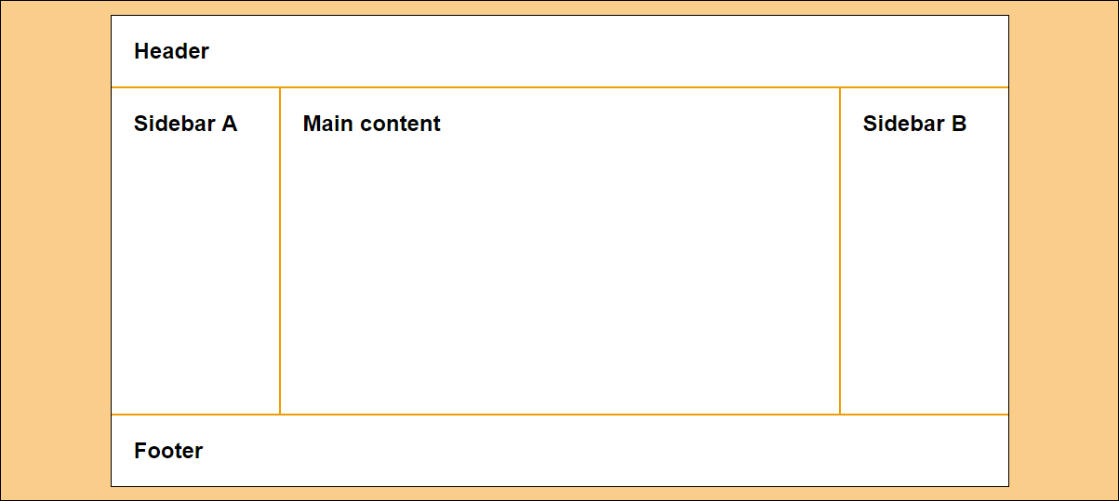
A 3-column page with fixed-width columns

Slide 13
The HTML for the 3-column page
<body>
<header>
<h2>Header</h2>
</header>
<aside id="sidebarA">
<h2>Sidebar A</h2>
</aside>
<main>
<h2>Main content</h2>
</main>
<aside id="sidebarB">
<h2>Sidebar B</h2>
</aside>
<footer>
<h2>Footer</h2>
</footer>
</body>

Slide 14
The CSS for the 3-column, fixed-width page
body {
width: 964px;
background-color: white;
margin: 15px auto;
border: 1px solid black; }
#sidebarA {
width: 180px;
height: 350px; /* to give the sidebar some height for its border */
float: left;
border-right: 2px solid #ef9c00; }
main {
width: 600px;
float: left; }
#sidebarB {
width: 180px;
height: 350px; /* to give the sidebar some height for its border */
float: right;
border-left: 2px solid #ef9c00; }

Slide 15
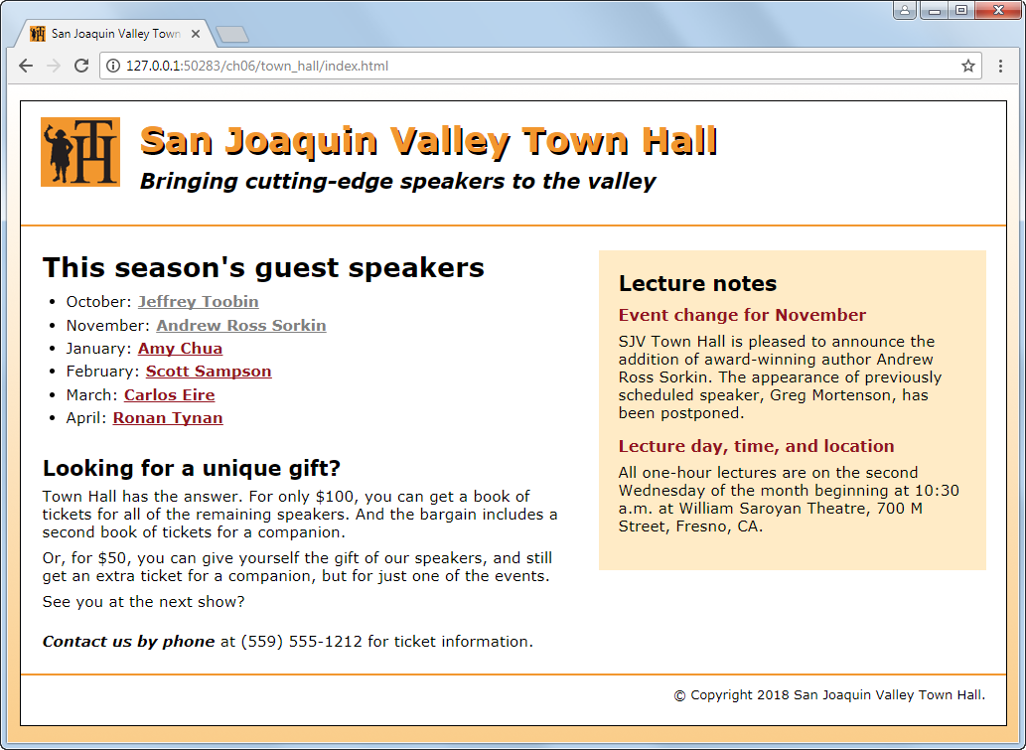
A home page with a sidebar floated to the right

Slide 16
The HTML for the home page (part 1)
<head>
...
<link rel="stylesheet" href="styles/normalize.css">
<link rel="stylesheet" href="styles/main.css">
</head>
<body>
<header>
<img src="images/logo.jpg" alt="Town Hall Logo" width="80">
<h2>San Joaquin Valley Town Hall</h2>
<h3>Bringing cutting-edge speakers to the valley</h3>
</header>
<main>
<aside>...</aside>
<section>...</section>
</main>

Slide 17
The HTML for the home page (part 2)
<footer>
<p>&copy; Copyright 2018 San Joaquin Valley Town Hall.</p>
</footer>
</body>
</html>

Slide 18
The CSS for the home page (part 1)
body {
font-family: Verdana, Arial, Helvetica, sans-serif;
font-size: 100%;
width: 990px;
background-color: white;
margin: 15px auto;
padding: 15px 0;
border: 1px solid black; }
section, aside, h1, h2, h3, p {
margin: 0;
padding: 0; }
section, aside {
margin-top: 1.5em;
margin-bottom: 1em; }

Slide 19
The CSS for the home page (part 2)
section {
width: 535px;
float: right;
margin-left: 20px;
padding-right: 25px;}
aside {
width: 350px;
float: right;
padding: 20px;
background-color: #ffebc6;
margin-right: 20px; }
footer {
clear: both;
border-top: 2px solid #f2972e;
padding-top: .7em; }

Slide 20
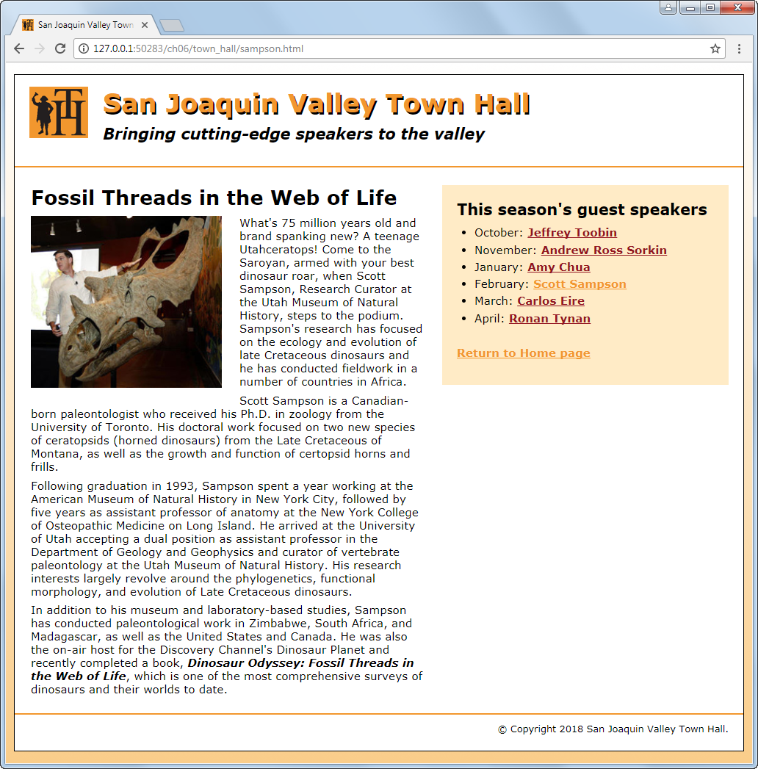
A speaker page with a sidebar on the right

Slide 21
The HTML for the speaker page
<head>
...
<link rel="stylesheet" href="styles/normalize.css">
<link rel="stylesheet" href="styles/speaker.css">
</head>
<body>
<header>...</header>
<main>
<aside>...</aside>
<article>...</article>
</main>
</body>

Slide 22
The CSS for the speaker page
article {
width: 535px;
float: right; }
aside {
width: 350px;
float: right; }
article img {
float: left; }

Slide 23
The primary CSS3 properties for creating text columns
column-count
column-gap
column-rule
3 columns with default-sized gaps
article {
column-count: 3; }
3 columns with 35px gaps and 2px rules between the columns
article {
column-count: 3;
column-column-gap: 35px;
column-rule: 2px solid black; }

Slide 24
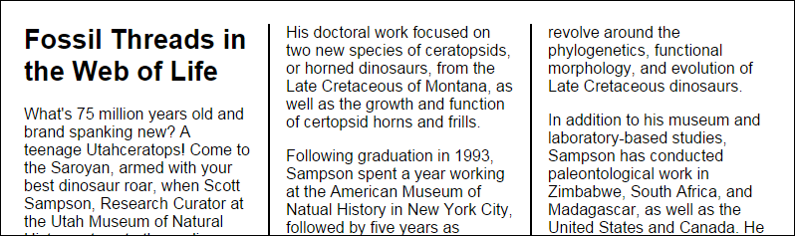
3 columns with 35px gaps and 2px rules in a browser window
Try it out
http://aaronlumsden.com/multicol/

Slide 25
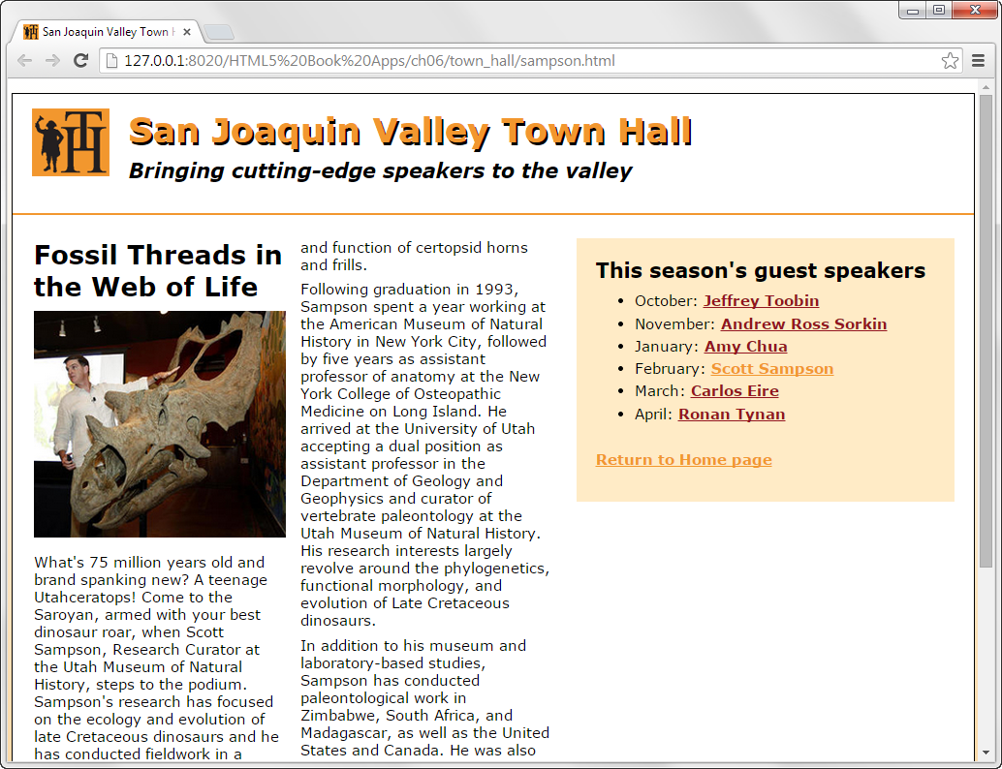
A web page with a two-column article

Slide 26
The CSS for creating the columns
article {
column-count: 2;
}

Slide 27
Properties for positioning elements
position
top, bottom, left, right
z-index
Possible values for the position property
static
absolute
fixed
relative
sticky
More Information
https://www.w3schools.com/css/css_positioning.asp

Slide 28
The HTML for a web page that will use positioning
<body>
<main>
<h1>Our speakers this season</h1>
<ul>
<li>October: <a href="speakers/toobin.html">
Jeffrey Toobin</a></li>
<li>November: <a href="speakers/sorkin.html">
Andrew Ross Sorkin</a></li>
<li>January: <a href="speakers/chua.html">
Amy Chua</a></li>
</ul>
<p>Please contact us for tickets.</p>
</main>
<aside>
<p><a href="raffle.html">Enter to win a free ticket!</a></p>
</aside>
</body>

Slide 29
The CSS for the web page with absolute positioning
body {
position: relative; } /* not needed for fixed positioning */
aside {
width: 80px;
position: absolute; /* change to fixed for fixed positioning */
right: 30px;
top: 50px; }

Slide 30
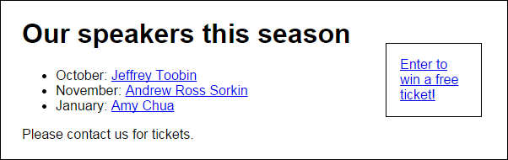
The web page with absolute positioning in a browser

Slide 31
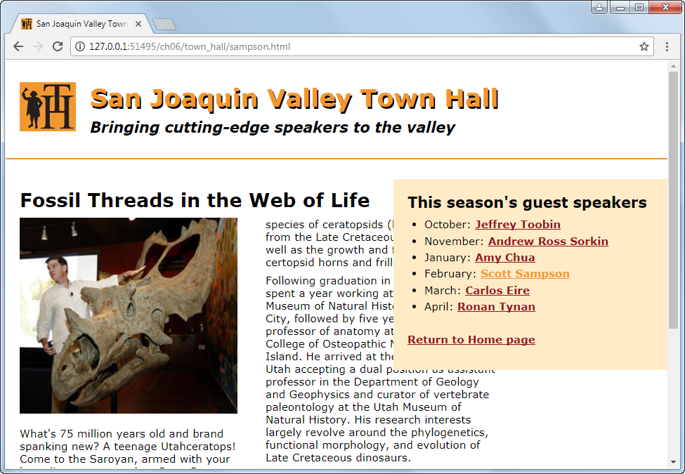
A sidebar that uses fixed positioning

Slide 32
The CSS for the positioned element
aside {
width: 350px;
position: fixed;
right: 0;
top: 170px;
}

Slide 33
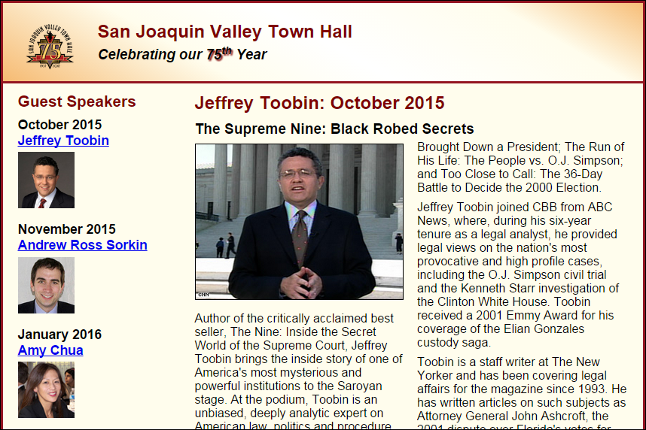
Short 6-1 Use the CSS3 columns feature

Slide 34

Short 6-2 Switch the columns of a page

Slide 35
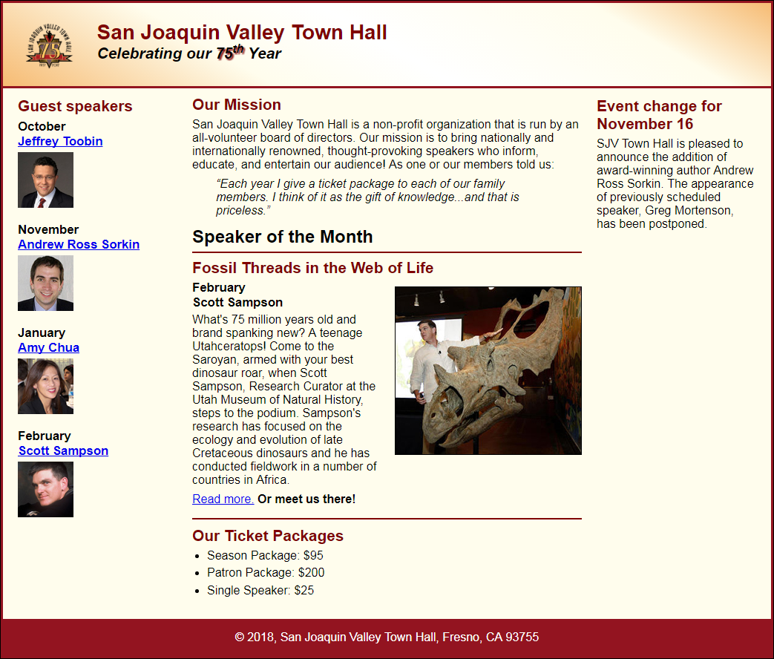
Short 6-3 Add a third column to a page

Slide 36
Objectives
Applied
Given an HTML document, create a CSS style sheet that uses floating to implement a fixed or fluid page layout in two- or three-column format with both header and footer.
Knowledge
Describe the use of floating for page layout.
Describe the use of the clear property in a CSS rule set.
Distinguish between fixed and fluid page layout.
Describe the use of the CSS3 feature for text columns.
Describe the use of absolute, relative, and fixed positioning.

